Slide 1
Cloud Services Deployment and Parallel Execution
Jenn-Wei Lin
Professor | Fu Jen Catholic University
Notes:
主題名稱
1.中文字型：微軟正黑體
2.英文字型：Calibri
3.大標字體：48
4.下標字體：30
講者姓名
1.講者提供英文姓名＋姓氏
2.格式： title | Advantech | version (從v1.0開始)
3.字型為Calibri 字體為20

Slide 2
1
This unit first mentions how to deploy services in a cloud platform by Kubernetes. The components of Kubernetes will be elaborated by illustrating the step-by-step operations.
Learning Objective
2
After deploying services, we introduce the MapReduce framework how to efficiently execute cloud services in parallel to speed up execution time.
3
In addition to the basic operations of Kubernetes and MapReduce, we further lecture some special functions in the service deployment and execution enhancement..
Notes:
本單元學習目標
1.請以1 2 3作為標題編號
2.中文微軟正黑體，英文為Calibri
3.內容字級大小：20

Slide 3
01
Kubernetes
Kubernetes Architecture
Kubernetes Components
Pods Creation Process Flow
Outline
02
MapReduce
MapReduce Operation
WordCount Example
MapReduce Scheduler
MapReduce Speculative Execution
Notes:
簡報大綱
1.列出單元及各小節名稱
2.請以01.02.03作為標題編號
3.大標大小30，粗體， 顏色：黑
4.自標題大小18，顏色： 黑
5.中文微軟正黑體，英文為Calibri
老師可依需求增減介紹項目，若一頁不夠可新增下一頁。

Slide 4
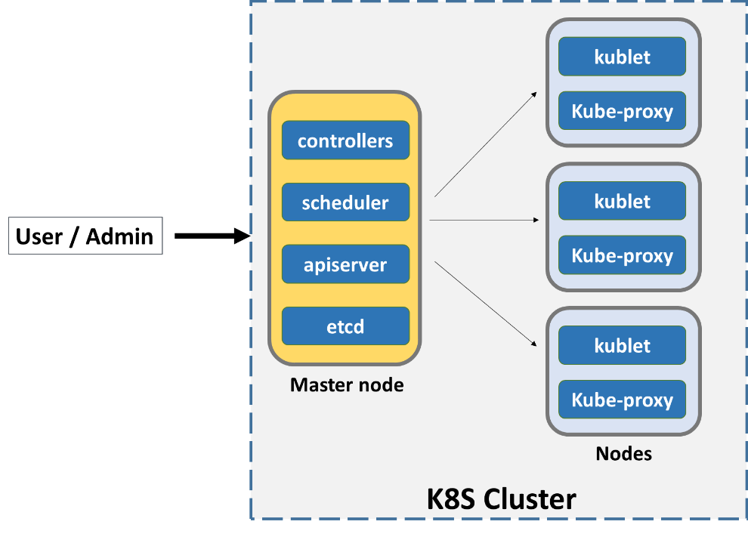
Kubernetes
Kubernetes(K8S) is an open-source based container orchestration platform.
Automating deployment, scaling, and management of containerized applications.
Four major components: cluster, master node, worker node, and pod.
A Kubernetes cluster consists of one or more master nodes . In addition, it also has a set of worker machines, called nodes that run containerized applications.
Master node
The Master node manages the worker nodes and pods in the cluster.
Worker node
The worker node(s) host the pods that are the components of the application workload.
Pod contains one or more containers.
Notes:
1. 中文微軟正黑體，英文為Calibri
2.標題字級：32置中
3.小標題字級：20
4.內文字級：16
5. 重點可以使用粗體
6.可依需求插入圖片及調整圖片大小
7.每頁皆依上下左右規範留白，規範邊限於編輯完成後即可刪除。

Slide 5
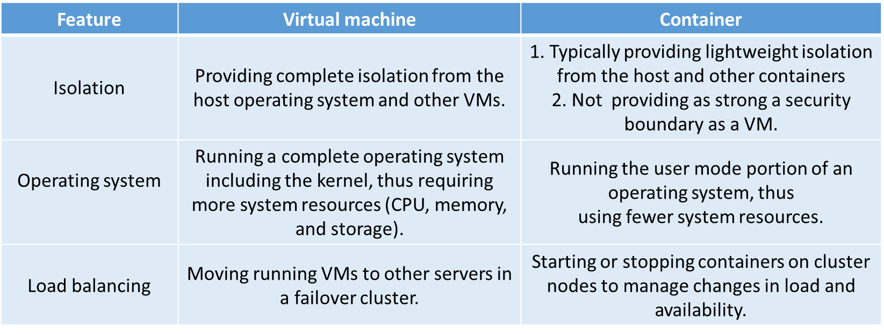
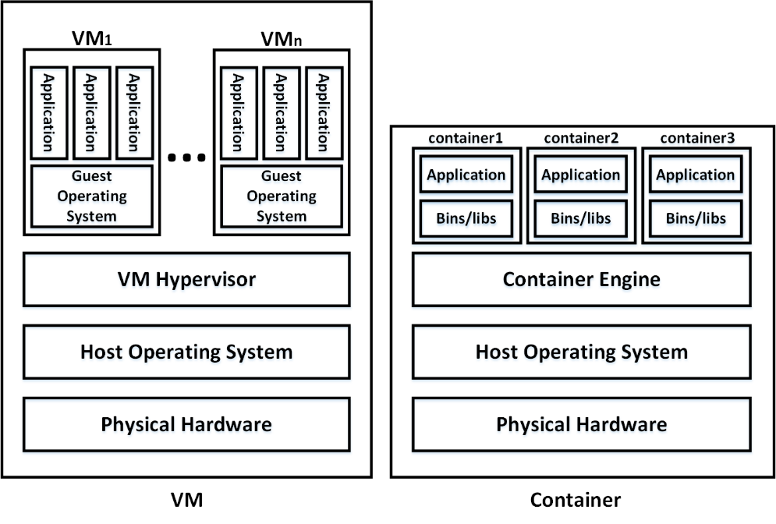
VM vs Container
Notes:
1. 中文微軟正黑體，英文為Calibri
2.標題字級：32置中
3.小標題字級：20
4.內文字級：16
5. 重點可以使用粗體
6.可依需求插入圖片及調整圖片大小
7.每頁皆依上下左右規範留白，規範邊限於編輯完成後即可刪除。

Slide 6
Kubernetes Architecture
Kubernetes Controller(Master Node) Plane
Kubernetes Worker Plane (Worker Nodes)
v
v
kube-controller
manager
kube-scheduler
Node
Node
Node
kube-proxy
kube-proxy
kube-proxy
kube-api-server
kubelet
kubelet
kubelet
Pods
Pods
Pods
v
Etcd
cloud-controller
manager
v
Cloud Infrastructure
https://kubernetes.io/docs/concepts/overview/components/
Notes:
https://cwhu.medium.com/kubernetes-basic-concept-tutorial-e033e3504ec0

Slide 7
Control Plane Components
Kube API server
Kube scheduler
The API server is a component of the Kubernetes control plane that exposes the Kubernetes API.
The API server is the front end for the Kubernetes control plane.
kube-apiserver is designed to scale horizontally—that is, it scales by deploying more instances. You can run several instances of kube-apiserver and balance traffic between those instances.
Control plane component that watches for newly created Pods with no assigned node, and selects a node for them to run on.
Factors taken into account for scheduling decisions include: resource requirements, affinity/anti-affinity specifications, data locality, inter-workload interference, deadline, etc.
Kube controller manager
Running multiple controllers, e.g. node controller, replication controller, etc.
Responsible for noticing and responding when nodes go and down.
Watching for job objects.
Etcd
Consistent and highly-available key value store used as Kubernetes' backing store for all cluster data.
Cloud-controller manager
Responsible for communicating with cloud platform API (e.g. Azure, AWS, Vmware, etc.)
Notes:
1. 中文微軟正黑體，英文為Calibri
2.標題字級：32置中
3.小標題字級：20
4.內文字級：16
5. 重點可以使用粗體
6.可依需求插入圖片及調整圖片大小
7.每頁皆依上下左右規範留白，規範邊限於編輯完成後即可刪除。

Slide 8
Worker Plane Components
Kubelet
Container runtime
Managing containers running in a worker node.
Communicating with the master node to report current states of the worker node.
Taking a set of PodSpecs that are provided through various mechanisms and ensuring that the containers described in those PodSpecs are running and healthy.
Running containers in a pod.
Pulling the container image from a repository.
Container runtime in Docker => Docker Engine
Pod
Kubernetes (K8S) schedule unit. One pod to one application
One pod contains one or more containers.
Kube proxy
Maintaining the network rules on a worker node that allow communication to pods from inside or outside the cluster.
Request through Kube proxy to container based on IP and port
Redirection traffic among relative pods for load balancing.
Notes:
1. 中文微軟正黑體，英文為Calibri
2.標題字級：32置中
3.小標題字級：20
4.內文字級：16
5. 重點可以使用粗體
6.可依需求插入圖片及調整圖片大小
7.每頁皆依上下左右規範留白，規範邊限於編輯完成後即可刪除。

Slide 9
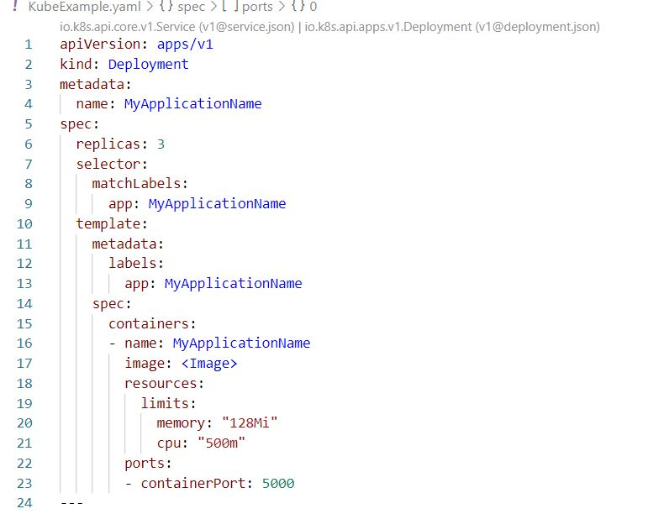
Pod Specification in YAML
Application name: lines 4, 9, 13, and 16
Replicas: line 6
Image: line 17
Container resources: lines 18-21
Network port: line 23
Notes:
1. 中文微軟正黑體，英文為Calibri
2.標題字級：32置中
3.小標題字級：20
4.內文字級：16
5. 重點可以使用粗體
6.可依需求插入圖片及調整圖片大小
7.每頁皆依上下左右規範留白，規範邊限於編輯完成後即可刪除。

Slide 10
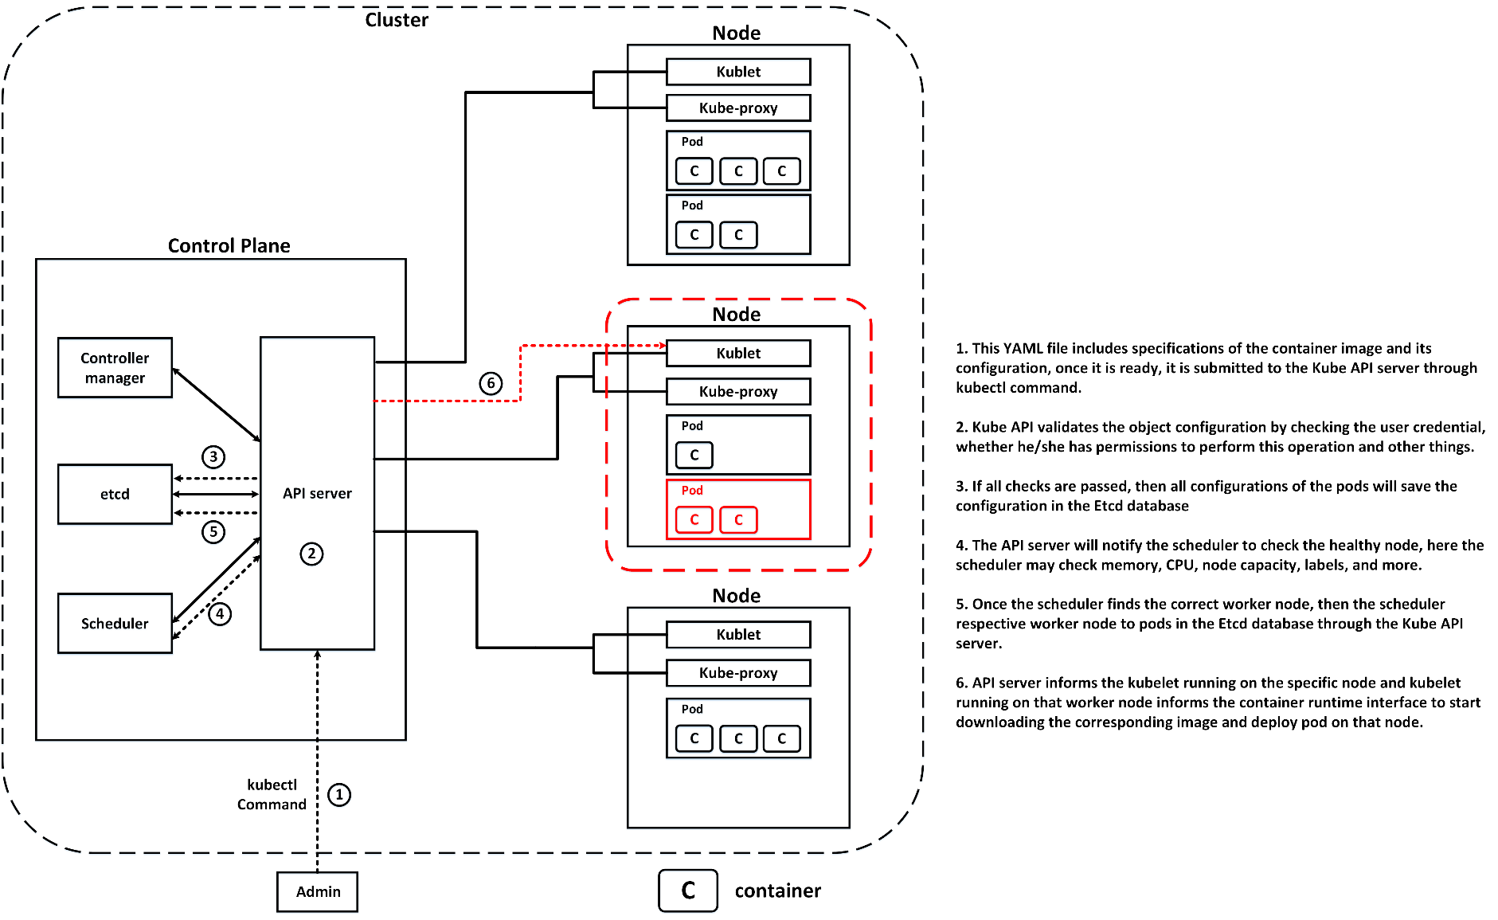
Pods Creation Process Flow
Notes:
1. 中文微軟正黑體，英文為Calibri
2.標題字級：32置中
3.小標題字級：20
4.內文字級：16
5. 重點可以使用粗體
6.可依需求插入圖片及調整圖片大小
7.每頁皆依上下左右規範留白，規範邊限於編輯完成後即可刪除。

Slide 11
High Availability and Load Balancing for Kubernetes
kubectl, Clients, etc
Load Balancer
api-server
api-server
api-server
kubelet
kubelet
kubelet
Master Node #1
Master Node #2
Master Node #3
Worker Node #1
Worker Node #2
Worker Node #3

Slide 12
High Availability for Kubernetes with Database
Clients
Load Balancer
Node 1
Node 2
Node 3
Proxy
Proxy
Proxy
Keeper
Keeper
Keeper
ProstgreSQL
(Standby)
ProstgreSQL
(Master)
ProstgreSQL
(Standby)
Replication
Replication
Notes:
Bosh佈署不支持3節點HA架構，HA架構需要手動佈署

Slide 13
01
Kubernetes
Kubernetes Architecture
Kubernetes Components
Pods Creation Process Flow
Outline
02
MapReduce
MapReduce Operation
WordCount Example
MapReduce Scheduler
MapReduce Speculative Execution
Notes:
簡報大綱
1.列出單元及各小節名稱
2.請以01.02.03作為標題編號
3.大標大小30，粗體， 顏色：黑
4.自標題大小18，顏色： 黑
5.中文微軟正黑體，英文為Calibri
老師可依需求增減介紹項目，若一頁不夠可新增下一頁。

Slide 14
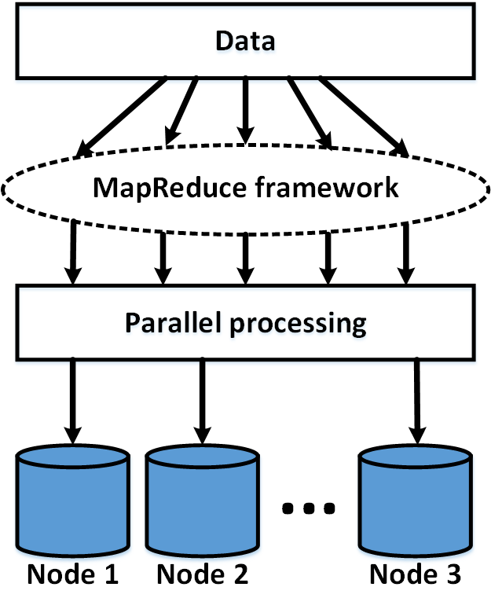
MapReduce
MapReduce is a parallel computing model for processing large-scale data sets on multiple nodes.
Analyzing huge amount of data.
Information retrieval from a large-size document.
Notes:
1. 中文微軟正黑體，英文為Calibri
2.標題字級：32置中
3.小標題字級：20
4.內文字級：16
5. 重點可以使用粗體
6.可依需求插入圖片及調整圖片大小
7.每頁皆依上下左右規範留白，規範邊限於編輯完成後即可刪除。

Slide 15
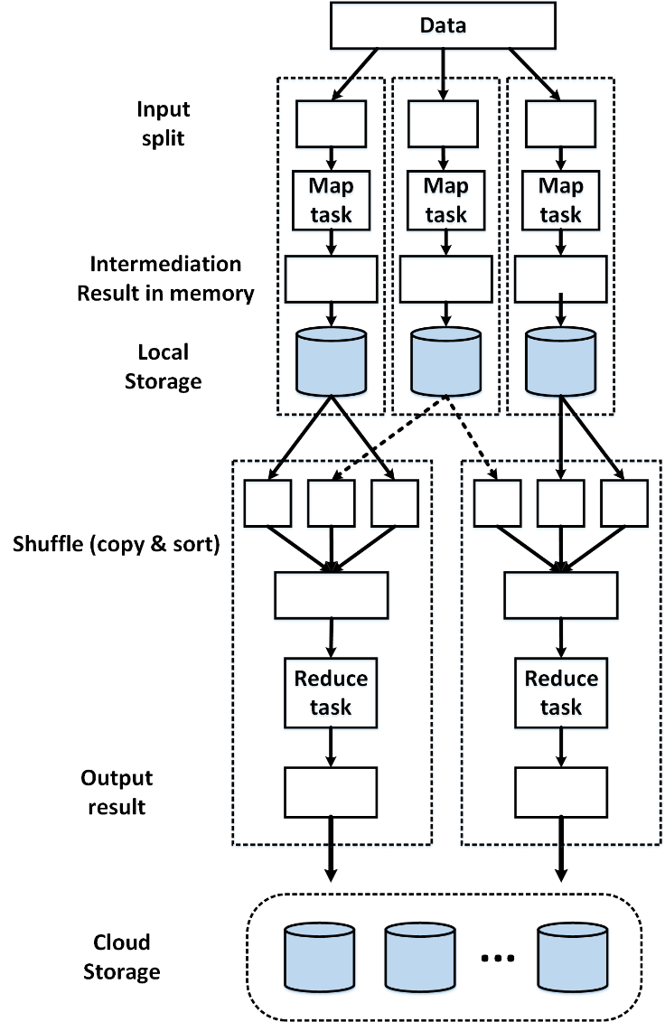
MapReduce Operation
The computation takes a set of input key/value pairs, and produces a set of output key/value pairs. The user of the MapReduce expresses the computation as two functions: Map and Reduce.
The Map function, written by the user, takes an input pair and produces a set of intermediate key/value pairs. The MapReduce library groups together all intermediate values associated with the same intermediate key and passes them to the Reduce function.
The Reduce function, also written by the user, accepts an intermediate key and a set of values for that key. Typically one output value is produced per Reduce function.
.
Notes:
1. 中文微軟正黑體，英文為Calibri
2.標題字級：32置中
3.小標題字級：20
4.內文字級：16
5. 重點可以使用粗體
6.可依需求插入圖片及調整圖片大小
7.每頁皆依上下左右規範留白，規範邊限於編輯完成後即可刪除。

Slide 16
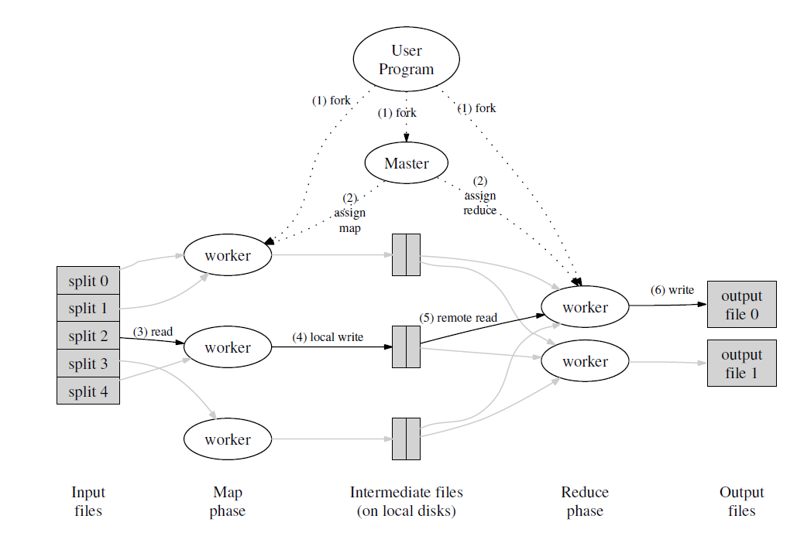
MapReduce Execution Flow
The MapReduce library in the user program first splits the input files into M pieces of typically 16 megabytes to 64 megabytes (MB) per piece.
There are M map tasks and R reduce tasks to assign. The master picks idle workers and assigns each one a map task or a reduce task.
A worker who is assigned a map task reads the contents of the corresponding input split. passes each key/value pair to the user-defined Map function. The intermediate key/value pairs produced by the Map function are buffered in memory.
Periodically, the buffered pairs are written to local disk. The locations of these buffered pairs on the local disk are passed back to the master, who is responsible for forwarding these locations to the reduce workers.
A reduce worker uses remote procedure calls to read the buffered data from the local disks of the map workers. It also sorts it by the intermediate keys so that all occurrences of the same key are grouped together.
The reduce worker iterates over the sorted intermediate data to the user’s Reduce function. The output of the Reduce function is appended to a final output file for this reduce partition.
Notes:
1. 中文微軟正黑體，英文為Calibri
2.標題字級：32置中
3.小標題字級：20
4.內文字級：16
5. 重點可以使用粗體
6.可依需求插入圖片及調整圖片大小
7.每頁皆依上下左右規範留白，規範邊限於編輯完成後即可刪除。

Slide 17
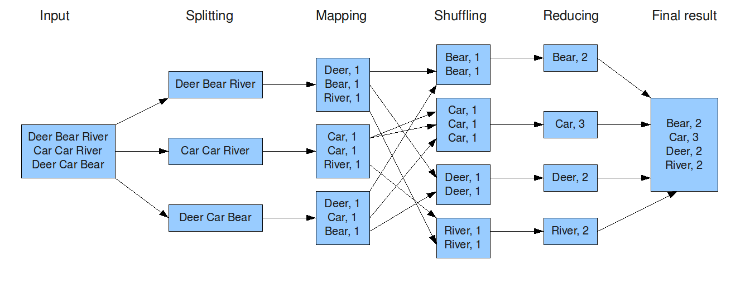
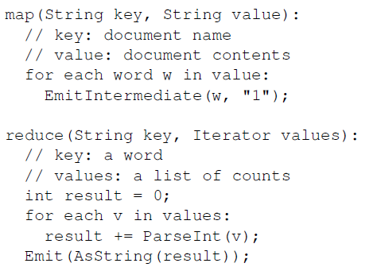
WordCount Example
The map function emits each word plus an associated
count of occurrences (just ‘1’ in this simple example).
The reduce function sums together all counts emitted
for a particular word.
Notes:
1. 中文微軟正黑體，英文為Calibri
2.標題字級：32置中
3.小標題字級：20
4.內文字級：16
5. 重點可以使用粗體
6.可依需求插入圖片及調整圖片大小
7.每頁皆依上下左右規範留白，規範邊限於編輯完成後即可刪除。

Slide 18
MapReduce Refinement
Data locality
Saving network bandwidth.
HDFS (GFS) divides each file into 64 MB blocks, and stores several copies of each block (typically 3 copies) on different node.
The MapReduce master takes the location information of the input files into account and attempts to schedule a map task on a machine that contains a replica of the corresponding input data.
The map task can locally read input data and consumes no network bandwidth.
Partitioning function
The users of MapReduce specify the number of reduce tasks/output files that they desire (R).
Data gets partitioned across these tasks using a partitioning function on the intermediate key.
A default partitioning function is provided that uses the hash function such as hash(key) mod R.
This tends to result in fairly well-balanced partitions.
Combiner function
In some cases, there is significant repetition in the intermediate keys produced by each map task to frequently send these intermediate data to the same reduce task.
We allow the user to specify an optional Combiner function that does partial merging of this data before it is sent over the network.
The Combiner function is executed on each machine that performs a map task. Typically the same code is used to implement both the combiner and the reduce functions.
The output of a combiner function is written to an intermediate file that will be sent to a reduce task.
Map output : (1950, 0), (1950, 20), (1950, 10), (1950, 25), (1950, 15)
No using combiner function to reduce input: 1950, [0, 20, 10, 25, 15])
Using combiner function to reduce input: (1950, 25) with assuming the max in reduce function
Notes:
1. 中文微軟正黑體，英文為Calibri
2.標題字級：32置中
3.小標題字級：20
4.內文字級：16
5. 重點可以使用粗體
6.可依需求插入圖片及調整圖片大小
7.每頁皆依上下左右規範留白，規範邊限於編輯完成後即可刪除。

Slide 19
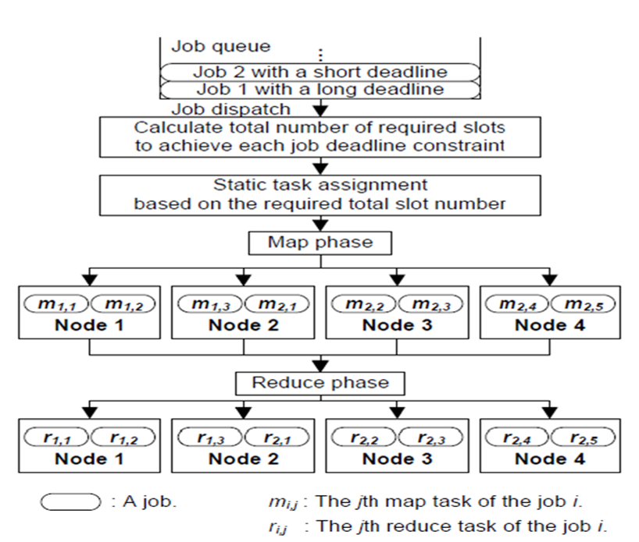
MapReduce Scheduler
FIFO scheduler
A default approach to scheduling users’ jobs.
All jobs run in order of submission.
Each job would use the resources of whole cluster, so that all of incoming jobs have to wait their turn.
Fair scheduler
All jobs get an equal share of resources over time.
When there is a single job running, that job uses the entire cluster.
When other jobs are submitted, a portion of resources are freed up for the new jobs, so that each job gets roughly the same amount of resources.
Unlike the default Hadoop scheduler, which forms a queue of jobs, this lets short jobs finish in reasonable time while not starving long jobs.
Notes:
1. 中文微軟正黑體，英文為Calibri
2.標題字級：32置中
3.小標題字級：20
4.內文字級：16
5. 重點可以使用粗體
6.可依需求插入圖片及調整圖片大小
7.每頁皆依上下左右規範留白，規範邊限於編輯完成後即可刪除。

Slide 20
MapReduce Speculative Execution
Considering heterogeneous performance among cloud servers.
If a node is available but is performing poorly (we call it a straggler), MapReduce runs a backup task (also called speculative task) on another machine to finish the computation faster. (The method is called speculative execution).
Without this mechanism of speculative execution, a job would be as slow as the misbehaving task. Google has noted that speculative execution can improve job response times by 44%.
Hadoop’s scheduler starts speculative tasks based on a simple heuristic comparing each task’s progress to the average progress below a given threshold value.
To select speculative tasks, Hadoop monitors task progress using a progress score between 0 and 1.
For a map task, the progress score is the fraction of input data read.
For a reduce task, the execution is divided into three phases (copy phase, sort phase, and reduce phase), each of which accounts for 1/3 of the score.
Three phases of a reduce task.
The copy phase: when the task is fetching map outputs.
The sort phase: when map outputs are sorting by key.
The reduce phase: when a user-defined function is being applied to the list of map outputs with each key.
For example
A task halfway through the copy phase has a progress score of $\frac{1}{2}∙\frac{1}{3}=\frac{1}{6}$
A task halfway through the reduce phase scores $\frac{1}{3}+\frac{1}{3}+\left(\frac{1}{2}∙\frac{1}{3}\right)=\frac{5}{6}$
Notes:
1. 中文微軟正黑體，英文為Calibri
2.標題字級：32置中
3.小標題字級：20
4.內文字級：16
5. 重點可以使用粗體
6.可依需求插入圖片及調整圖片大小
7.每頁皆依上下左右規範留白，規範邊限於編輯完成後即可刪除。

Slide 21
MapReduce Fault Tolerance
Worker node failure
The master pings every worker periodically. If no response is received from a worker node in a certain amount of time, the master node marks the worker as failed.
Any map task completed by the worker node is reset back to their initial idle state, and therefore become eligible for scheduling on another worker node.
The reason is that their output of the completed map task is stored on the local disk of the failed node and is therefore inaccessible.
Similarly, any map task or reduce task in progress on a failed worker is also reset to idle and becomes eligible for rescheduling.
Completed reduce tasks do not need to be re-executed since their output is stored in a permeant cloud file system.
When a map task is executed first by worker node A and then later executed by worker node B (because A failed), all worker nodes executing reduce tasks are notified of the re-execution. Any reduce task that has not already read the data from worker node A will read the data from worker node B.
Master node failure
It is easy to make the master write periodic checkpoints of the master node on permeant storage.
The checkpoint includes the CPU and memory states of the master node.
If the master node dies, the last checkpoint is restored on another node as a new master node.
Notes:
1. 中文微軟正黑體，英文為Calibri
2.標題字級：32置中
3.小標題字級：20
4.內文字級：16
5. 重點可以使用粗體
6.可依需求插入圖片及調整圖片大小
7.每頁皆依上下左右規範留白，規範邊限於編輯完成後即可刪除。

Slide 22
Reference
[1] (2022). Kubernetes [Online]. Available: https://kubernetes.io/
[2] (2022). Kubernetes Architecture [Online].Available: https://avinetworks.com/glossary/kubernetes-architecture/
[3] (2020). Kubernetes Cluster Deployment [Online].Available: https://www.bluematador.com/blog/building-and-deploying-to-kubernetes
[4] M. G. Xavier et al., “Performance Evaluation of Container-Based Virtualization for High Performance Computing Environments,” Proc. 2013 21st Euromicro Int’l. Conf. Parallel, Distrib. Network-Based Processing, 2013, pp. 233–40.
[5] B. Burns, K. Hightower, and J. Beda, Kubernetes: Up and Running: Dive Into the Future of Infrastructure. O’Reilly Media, 2017.
[6] N. Nguyen and T. Kim, “Toward Highly Scalable Load Balancing in Kubernetes Clusters, ” in IEEE Communications Magazine, July 2020, vol. 58, no. 7, pp. 78-83.
[7] (2015). Apache Hadoop MapReduce [Online]. Available: https://hadoop.apache.org/docs/r1.2.1/mapred_tutorial.html
[8] J. Dean and S. Ghemawat, “MapReduce: Simplified Data Processing on Large Clusters,” ACM Commun, Jan. 2008, vol. 51, pp. 107–113.
[9] M. Zaharia, A. Konwinski, A. D. Joseph, R. Katz, and I. Stoica, “Improving MapReduce performance in heterogeneous environments,” in Proc. 8th USENIX Conf. Operating Syst. Des. Implementation, 2008, pp. 29–42.
[10] B. T. Rao and L. S. S. Reddy, “Survey on improved scheduling in Hadoop MapReduce in cloud environments,” Int. J. Comput. Appl., Nov. 2011, vol. 34, no. 9, pp. 29–33.
[11] Q. Chen, C. Liu, and Z. Xiao, “Improving MapReduce performanceusing smart speculative execution strategy,” IEEE Trans. Comput., Apr. 2014, vol. 63, no. 4, pp. 954–967.
Notes:
資料、圖片來源需文章中註明出處於章節最後編輯參考來源資料。

