Slide 1
CHAP 4
MACRO PROCESSORS

Slide 2
Macro Processors
Macro instruction represents a commonly used group of statements in the source programming language. Expanding the macros by the macro processor.

Slide 3
Definition and Expansion
Program has the same functions and logic as the sample program, the numbering scheme used for the source statements.
Program defines and uses two macro instructions, RDBUFF, the WRBUFF macro is similar to the WRREC.

Slide 4
Definition and Expansion
MACRO and MEND are used in macro, (line 10) identifies the beginning of a macro definition. The operand field identify the parameters of the macro invocation statement that gives the arguments to be used in expanding.
Input to a macro processor, output that would be generated, expended into the macro invocation corresponds to the first parameter.

Slide 5
Macro invocation and
Subroutine call
The most significant difference between macro invocation and subroutine call :
statements that from the expansion of a macro are generated each time the macro is invoked but statements in a subroutine call appear only once, regardless of how many times the subroutine is called.

Slide 6
Macro invocation and
Subroutine call
The macro invocation statement itself has been included as a comment documentation of statement written by the programmer. Macro instruction in exactly the same way as an assembler language mnemonic.
The expanded file used as input to the assembler. A duplicate label definition, eliminated from the body of our macro definitions.

Slide 7
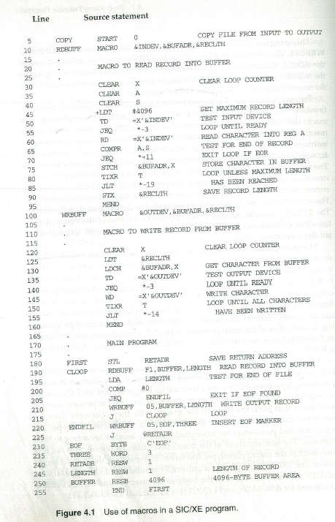

Slide 8
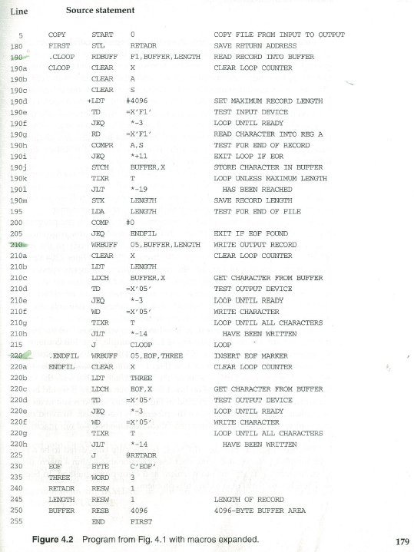

Slide 9
Subroutine call
V.S.
Macro call
RDBUFF
WRBUFF
Main
呼叫 兩次
RDREC
Macro call 耗費 程式空間, 執行速度 快
Main
WRREC
EXPAND
…
190a
190m
210a
210h
220a
220h
RDBUFF
Fig2.5
Subroutine call 節省 程式空間,因 need stack structure 所以 執行速度慢
WRBUFF
WRBUFF
Main

Slide 10
Macro and no Macro
Compare the example program in
figure 4.1 with 2.5.
Fig 4.1
Fig 4.5
Fig 4.2
define
expand
Fig 4.4

Slide 11
Macro Process
Source code
macro process
define
Macro processor
expand
Marco data structure
Assembler
Object code

Slide 12
Data structures in
Macro processor
There are three main data structures involved in macro processor :
DEFTAB : define table, the macro body,
NAMTAB : name table, DEFTAB,
ARGTAB : arguments.
index to

Slide 13
Data structures in
Macro processor
Two-pass macro processor in which all macro definitions during the first pass, and invocation statements are expanded during the second pass, macro instruction definitions in Fig. 4.3.

Slide 14
Data structures in
Macro processor
Processor that can alternate between macro definition is able to handle macros like those in Fig. 4.3. Macro invocation statement that preceded the definition of the confusing anyone reading the program.
Definition table (DEFTAB), comment lines the macro definition are not DEFTAB. The macro entered into NAMTAB, an index to DEFTAB. For the beginning and end in DEFTAB.

Slide 15
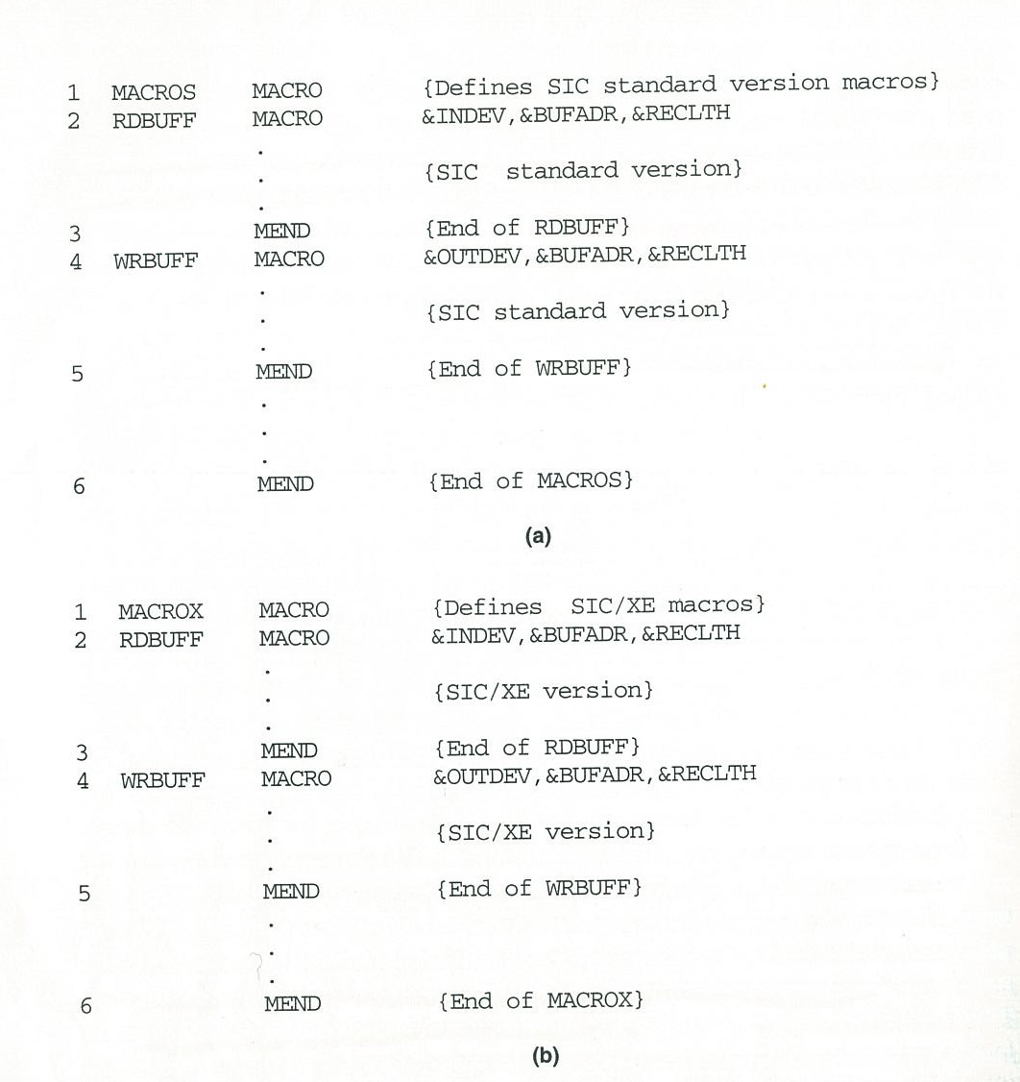
Figure 4.3 Example of the definition of macros within a macro body

Slide 16
Data structures in
Macro processor
Argument table (ARGTAB), the arguments are stored in ARGTAB according to their position in the argument list. ARGTAB are substituted for the corresponding parameters in the macro body.
Figure. 4.4(a) shows the definition, entry in NAMTAB identifying the beginning and end of the definition.

Slide 17
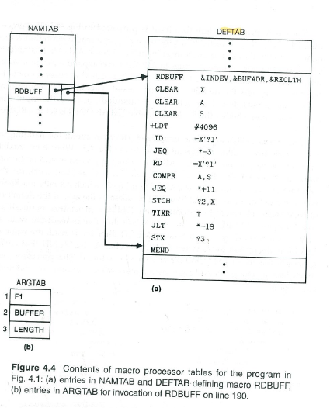

Slide 18
Data structures in
Macro processor
The parameter &INDEV has been converted to ?1 (indicating the first parameter in the prototype), &BUFADR has been converted to ?2, and so on. Notation is recognized in a line from DEFTAB.
The procedure DEFINE, which is called when the beginning of a macro definition is recognized, DEFTAB and NAMTAB. EXPAND is called to set up the argument values in ARGTAB.

Slide 19
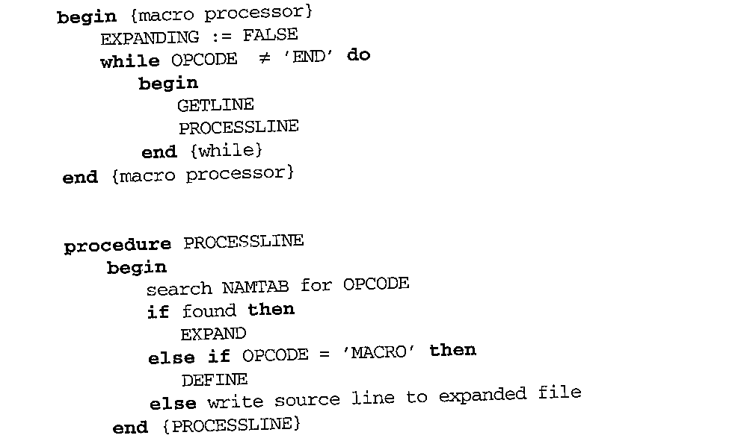
Data structures in
Macro processor
The normal approach would be to directive is reached. DEFINE procedure maintains named LEVEL. Each time a MACRO directive is read, the value of LEVEL is increased by 1; MEND directive is read, the value of LEVEL is decreased by 1.
Figure 4.5 Algorithm for a one-pass macro processor

Slide 20
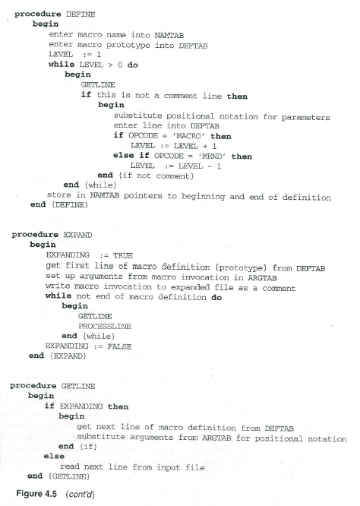
Figure 4.5 cont’d

Slide 21
Fig4.5 Algorithm for a one-pass macro processor
GETLINE
macro
… GETLINE
PROCESSLINE
Read next
PROCESSLINE
Found macro
Write source to expand (fig 4.2)
EXPAND
NAMTAB
DEFTAB
RDBUFF
WRBUFF
DEFINE
RDBUFF
ARGTAB
WRBUFF
3,4.while~
end{while} 用來處理 macro中再定 義macro使用 (如Fig4.3)
2.enter macro prototype into DEFTAB
1.enter macro name in NAMTAB

Slide 22
Data structures in
Macro processor
Mention before, these extended features are not directly related to the architecture of the computer for Concatenation of Macro Parameters.

Slide 23
Data structures in
Macro processor
4.2.1 Concatenation of Macro Parameters
The parameter &ID is concatenated after the character string X and character string 1, and followed by the parameter &ID1.
Most macro processors deal with this problem by providing a special concatenation operator. The parameter &ID is clearly identified. The character $→$will not appear in the expansion.

Slide 24
Data structures in
Macro processor
Concatenation of macro parameters : concatenates macro instruction parameters with other character.
define
SUM MACRO &ID
LDA X&ID 1
use
SUM A
LDA XA1
SUM BETA
LDA
XBETA1

Slide 25
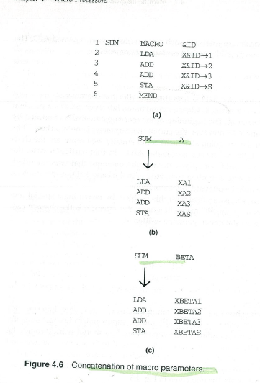

Slide 26
4.2.2 Generation of Unique Labels
Definition would prevent correct assembly of the resulting expanded program.
Technique for generating unique labels within expansion. Labels used within the macro body begin with the special character $. Replacing $ with $AA, the character $ will be replaced by $xx.

Slide 27
4.2.2 Generation of Unique Labels
Method for generating unique labels within macro expansions lets the labels beginning with the special character $.
During expansion each symbol beginning with $ has been modified by replacing $ with $AA.
ex. 1st $AA, 2nd $AB, 3rd $AC

Slide 28
4.2.3
Conditional macro expansion
1/13
These statement could be varied by the substitution of parameters, the sequence of statements generated for a macro expansion, the arguments supplied in the macro invocation.
For this reason, we prefer to use the term conditional macro expansion.
Definition of RDBUFF has two additional parameters: &EOR, which specifies .

Slide 29
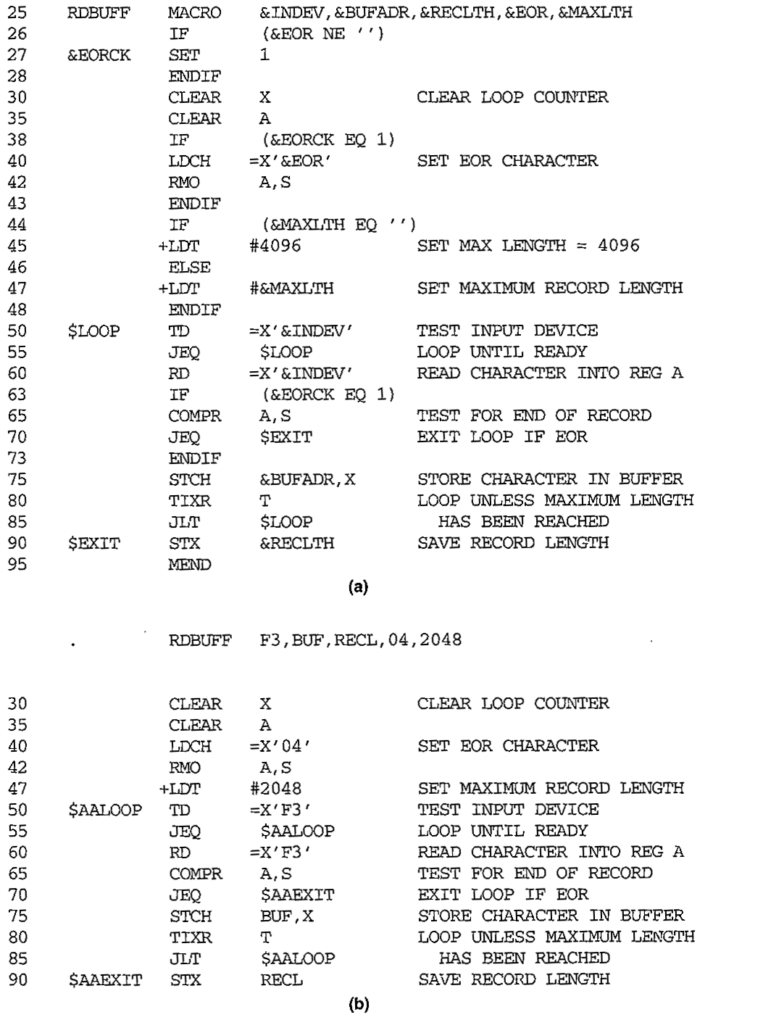
2/13
Figure 4.8 Use of macro- time conditional statements.

Slide 30
4.2.3
Conditional macro expansion
3/13
The statements on lines 44 though 48 of this definition illustrate conditional structure. &MAXLTH is equal to the null string, the statement on line 45 is generated. Otherwise, the statement on line 47 is generated.

Slide 31
4.2.3
Conditional macro expansion
4/13
(1)
A simple macro-time conditional structure:
IF-ELSE-ENDIF

Slide 32
4.2.3
Conditional macro expansion
5/13
The conditional macro expansion features just described is relatively simple. Processor must maintain a symbol table that contains the values of all macro-time variables used.
IF statement is encountered during the expansion of a macro, processor continues to process lines from DEFTAB until it encounters the next ELSE or ENDIF statement.

Slide 33
4.2.3
Conditional macro expansion
6/13
Fig. 4.9 show anther definition of RDBUFF. The macro-time variable &EORCT has previously been set (line 27) to the value %NITEMS(&EOR).

Slide 34
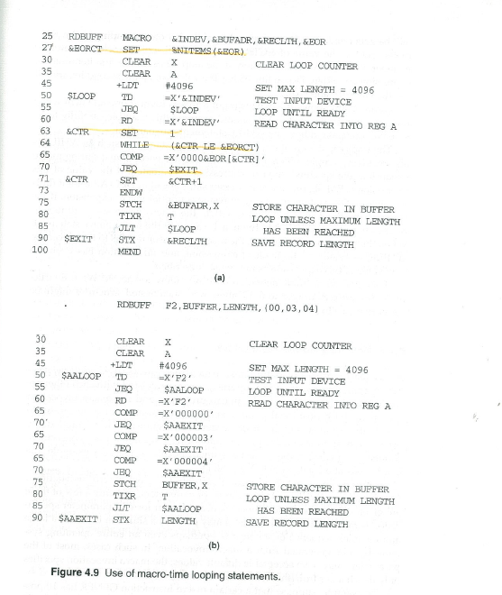
Figure 4.9

Slide 35
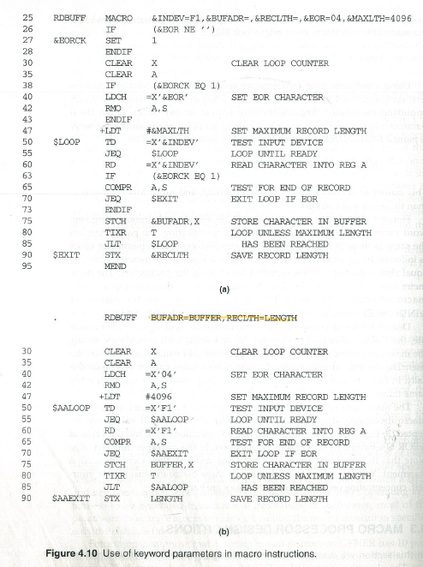
Figure 4.10

Slide 36
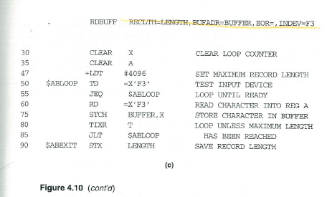
Figure 4.10

Slide 37
4.2.3
Conditional macro expansion
7/13
The implementation of a macro-time looping statement such as WHILE is also relatively simple. The specified Boolean expression is evaluated. FALES, the macro processor skips ahead in DEFTAB until it.

Slide 38
4.2.3
Conditional macro expansion
8/13
(2)
A macro-time variable :
&EORCK

Slide 39
4.2.3
Conditional macro expansion
9/13
(3)
The implementation of the conditional macro expansion:
(Boolean expression)

Slide 40
4.2.3
Conditional macro expansion
10/13
(4)
A macro-time looping statement:
WHILE-ENDW

Slide 41
4.2.3
Conditional macro expansion
11/13
(5)
A macro processor faction %NITEMS:
if &EOR=(00,03,04),
then %TNITEMS(&EOR)=3

Slide 42
4.2.3
Conditional macro expansion
12/13
(6)
A macro-time counter variable
&CTR

Slide 43
4.2.3
Conditional macro expansion
13/13
(7) How do you implement nested IF or nested WHILE
macro-time conditional statement?
Sol: modify the algorithm in Fig4.5

Slide 44
4.2.4
Keyword macro parameters
Keyword macro parameters have seen thus far used positional parameters. Parameters and arguments were associated with each other according to their positions in the macro prototype and the macro invocation.
Macro has a large number of parameters, and only a few of these are given values in a typical invocation.

Slide 45
4.2.4
Keyword macro parameters
particular invocation of the macro, positional parameters were used, the macro invocation statement might look like keyword parameters, parameter in any order.
GENER TYPE=DIRECT, CHANNEL=3
A version of the RDBUFF macro definition using keyword parameters.

Slide 46
4.2.4
Keyword macro parameters
Using keyword parameters, each argument values is written with a keyword that names the corresponding parameter.
ex.
define
RDBUFF MACRO
&INDEV=F1, &BUFADR=,
&RECLTH=, &EOR=04, &MAXLTH=4096
use
RDBUFF
MACRO
BUFADR=BUFFER, RECLTH=LENGTH Fig 4.10

Slide 47
4.2.4
Keyword macro parameters
Using keyword parameters, each argument values is written with a keyword that names the corresponding parameter.
ex.
define
RDBUFF MACRO
&INDEV=F1, &BUFADR=,
&RECLTH=, &EOR=04, &MAXLTH=4096
use
RDBUFF
MACRO
BUFADR=BUFFER, RECLTH=LENGTH Fig 4.10

Slide 48
4.3 Macro parameters design options
The algorithm presented in Fig. 4.5 does not work properly if a macro
RDBUFF BUFADR=BUFFER, RECLTH=LENGTH
RDBUFF RECLTH=LENTH, BUFADR=BUFFER,
EOR=, INDEV=F3
desirable to allow macros to be used in this way, possibilities for the solution of these problems.

Slide 49
4.3.1
Recursive macro expansion
The definition of one macro instruction. However, dealt with the invocation of one macro. Example of such a use of macros assumed that a related macro instruction already exists. This macro appears in Fig. 4.11(b). Macro like RDCHAR in the definition of RDBUFF so that
50 $LOOP RDCHAR &INDEV
The algorithm were applied to the macro invocation statement in Fig. 4.11(c).

Slide 50
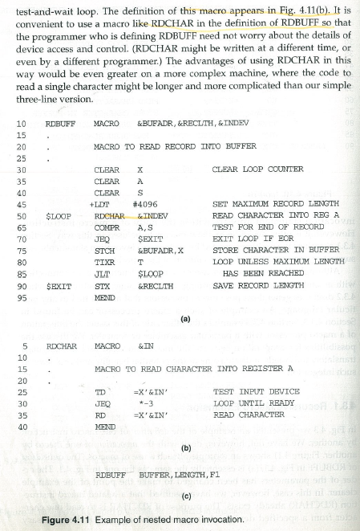
Figure 4.11

Slide 51
4.3.1
Recursive macro expansion
ARGTAB as follows:
The Boolean variable EXPANDING, would be set until line 50, a statement invoking RDCHAR. PROCESSLINE would call EXPAND again.
Parameter | Value
1 | BUFFER
2 | LENGTH
3 | F1
4 | (unused)
˙ | ˙

Slide 52
4.3.1
Recursive macro expansion
RDCHAR was recognized, EXPANDING would be set to FALSE. The macro processor would “forget” that it had been in the middle of expanding a macro when it encountered the RDCHAR statement.
These difficulties is the recursive call of the procedure is encountered, EXPAND is called. PROCESSLINE for line 50, which results in another call to EXPAND before a return is made from the original call. PROCESSLINE should be made to the main (outermost) loop of the loop within EXPAND.

Slide 53
4.3.1
Recursive macro expansion
Processor is being a programming language that allows recursive calls. The compiler would be sure that previous values of any variables within a procedure were saved when procedures at all, implementation can be found.

Slide 54
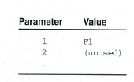
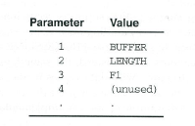
4.3.1
Recursive macro expansion
The algorithm of a macro processor described in figure 4.5 cannot handle the invocations of macros within macros. the problem can be solved by using stack structure.
RDBUFF BUFFER, LENGTH, F1

Slide 55
4.3.2 General-purpose macro processors
Why are there few general-purpose macro processors?
--easy for beginner, detail free.
parameter substitution, ex. comments ;
grouping structure, ex. begin-end ;
tokens, ex. := ;
syntax for macro definition and invocation.

Slide 56
4.3.2 General-purpose macro processors
These are not dependent on any particular programming language, with a variety of different languages.
Keywords such as begin and end for groping statements.
The programming language for example, identifiers, constants, operators, and keywords statements.

Slide 57
4.3.3 Macro processing
within language translators 1/5
Pre-processors
Line-by-line macro processor :
macro efficient.
easy to give diagnostic messages.
loosed-coupled relation.

Slide 58
4.3.3 Macro processing within language translators 2/5
Macro definitions and expanded version of the source program. The macro processing functions with the language translator itself.
The macro processor operates as a sort of input routine for the assembler or compiler.

Slide 59
4.3.3 Macro processing within language translators 3/5
Extra pass over the source program, OPTAB in an assembler and NAMTAB implemented in the same table. A line-by-line macro processor also makes it easier to give diagnostic mess ages that are related to the source statement containing to backtrack to discover the original source of trouble.

Slide 60
4.3.3 Macro processing
within language translators 4/5
(3) Integrated macro processor :
A FORTRAN compiler must be able to recognize and handle situations such as follows:
Do 100 I=1,20
對於I相對20..
Do 100 I=1 變數Do 100 I設為1
disadvantages :
more expensive
larger and more complex

Slide 61
4.3.3 Macro processing within language translators 5/5
Assignment statement that gives the variable DO100I, the variable name I and handle situations such as this.
Integrated macro processor can support macro instructions that depend upon the processor development must cost of the language translator with limited memory.

